Slide 1
Growth and Sentiment Analysis
on Coronavirus
Project presentation by
Anmol Kumar
170906482
Tanmay Ambegaokar
170906292
Under the guidance of
Prof Satyakam
Dept. of Electrical & Electronics Engineering
MIT Manipal

Slide 2
INTRODUCTION
Data, if analysed and modelled properly, a variety of results can be generated.
Data available in csv or tsv format.
For our project, two kinds of analysis will be done
Growth Analysis
Sentiment Analysis

Slide 3
INTRODUCTION
Growth Analysis
We will be conducting growth analysis on SARS 2003 and Covid-19 in India.
This analysis will tell us how quickly these pandemics spread to different regions.
To predict the growth, we will be using three different algorithms – Linear Regression, Logistic Regression, Gompertz Curve Model

Slide 4
INTRODUCTION
Sentiment Analysis
The severity of the pandemic led to fast tracking the clinical trials of vaccines which caused paranoia among masses.
The sentiment analysis on the tweets related to Covaxin and Covishield will help us to understand the general mood of the public classified into –
Positive sentiments
Negative sentiments
Neutral sentiments.

Slide 5
LITERATURE REVIEW
Growth Analysis
[1] “Modelling and Forecasting Covid-19 Growth Curve in India”
by Vikas Kumar Sharma and Unnati Nigam
[2] “Modelling and predicting the spatio-temporal spread of COVID-19 in Italy”
by Diego Guiliani, Maria Michela Dickson and Flavio Santi
[3] “Modelling avian growth with the unified-Richards”
by Tjørve KCM and Tjørve E.

Slide 6
LITERATURE REVIEW
Sentiment Analysis
[4] “Disinformation, ‘Fake News’ and influence Campaigns on Twitter ”
by Matthew Hindman, George Washington University
[5] “Sentiment analysis of social media response on the covid19 “
by Bhat, M., Qadri, M., Noor-ul-Asrar Beg, M. K., Ahanger, N., & Agarwal, B. (2020)
[6] “Public Sentiment Analysis of COVID19 Vaccination Drive in India ”
by Dr. Akash D Dubey, Jaipuria Institute of Management, Jaipur

Slide 7
OBJECTIVES
To predict the growth and spread of SARS 2003 in various countries.
To find the progress and development of Covid-19 in India.
To find the best model which predicts the growth of coronavirus.
To understand the sentiments of public regarding the Covaxin and Covishield vaccine.

Slide 8
OBJECTIVES
Objectives of Anmol Kumar
To perform Linear Regression on SARS 2003 and Covid-19 dataset.
To extract tweets with #covaxin from the twitter API and then converting them into datasets in the form of csv files.
To pre-process the data collected from twitter using the nltk python package to make it ready for analysis.
To perform Sentiment Analysis using the VADER tool.

Slide 9
OBJECTIVES
Objectives of Tanmay Ambegaokar
To clean the SARS 2003 and Covid-19 datasets
To do the visualization of the data which involves plotting graphs.
To perform Logistic Regression and Gompertz Curve Model and evaluate the model to find accuracy and error rate of the designed model.
To extract tweets #covishield from the twitter API and then converting them into datasets in the form of csv files.

Slide 10
METHODOLOGY(GROWTH ANALYSIS)
Data Cleaning
Data Pre-Processing
Visualization of Data
Modelling the Data
Evaluating the data
SARS 2003 Global
Covid-19 in India
Unnecessary columns were deleted
The total number of cases for each country and each state is plotted on a a graph.
Linear Regression
Gompertz Curve Model
Logistic Regression
MAE score
R2 score

Slide 11
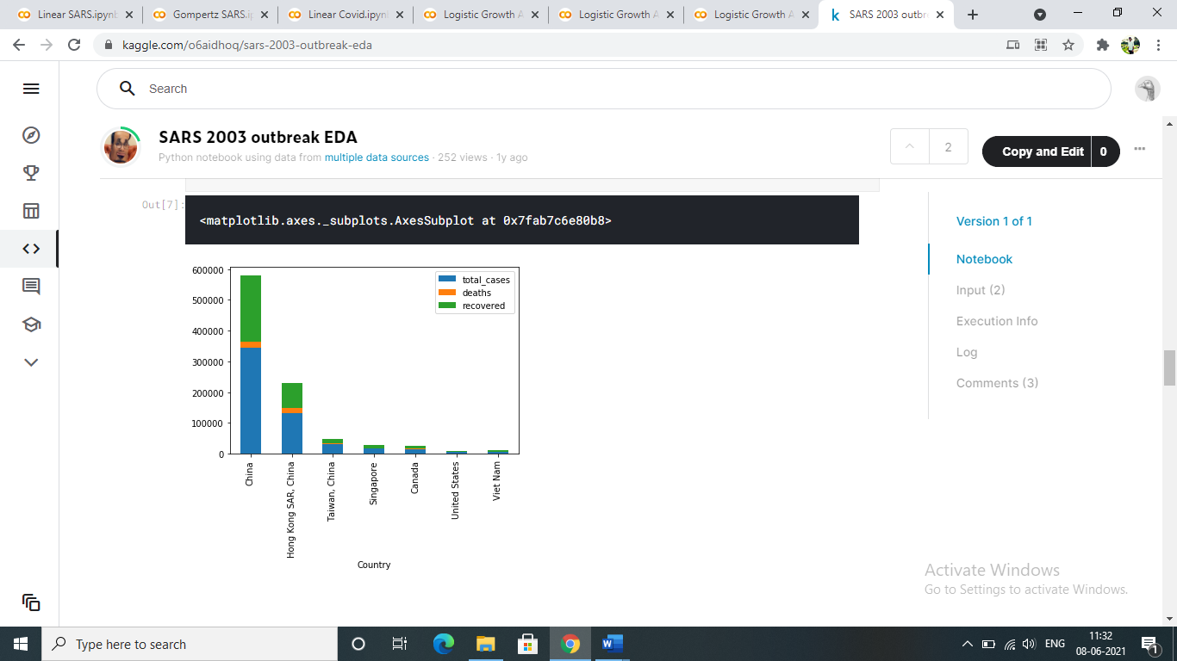
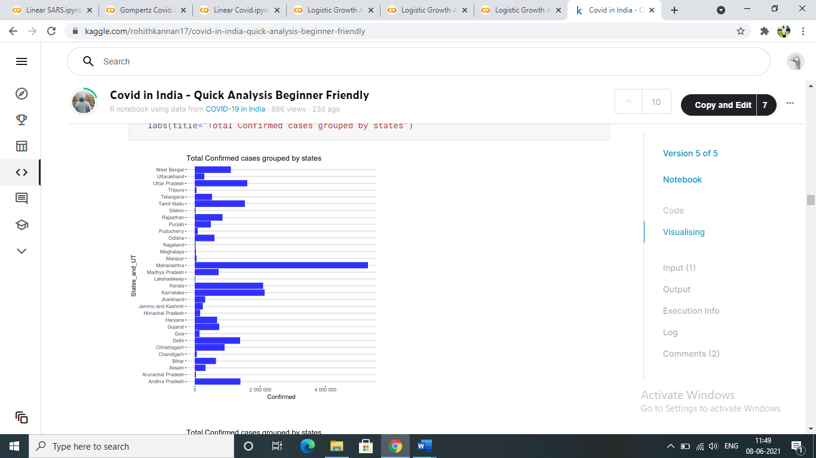
RESULTS AND ANALYSIS (GROWTH ANALYSIS)
VISUALISATION FOR BOTH DATASETS
Fig. For SARS 2003 Global dataset Fig. For Covid-19 in India

Slide 12
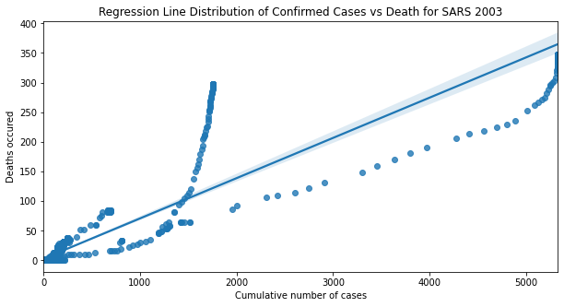
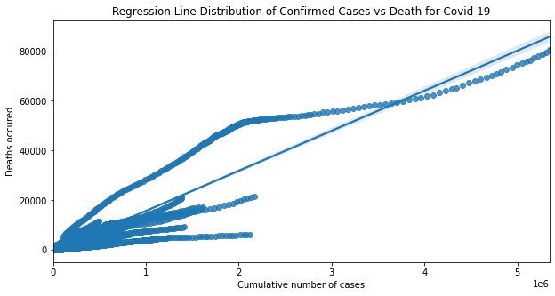
RESULTS AND ANALYSIS (GROWTH ANALYSIS)
Linear Regression
Fig. For SARS 2003 Global Fig. For Covid-19 in India

Slide 13
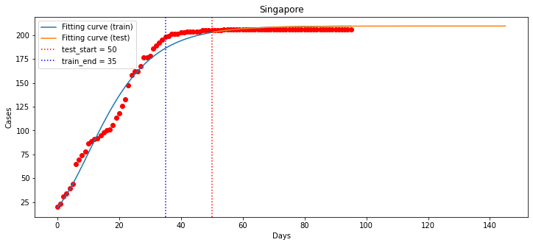
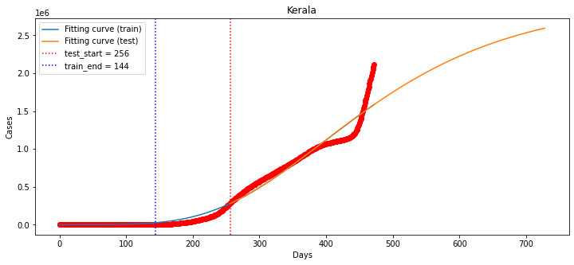
RESULTS AND ANALYSIS (GROWTH ANALYSIS)
Gompertz Curve Model
Fig. For SARS 2003 Global Fig. For Covid-19 in India

Slide 14
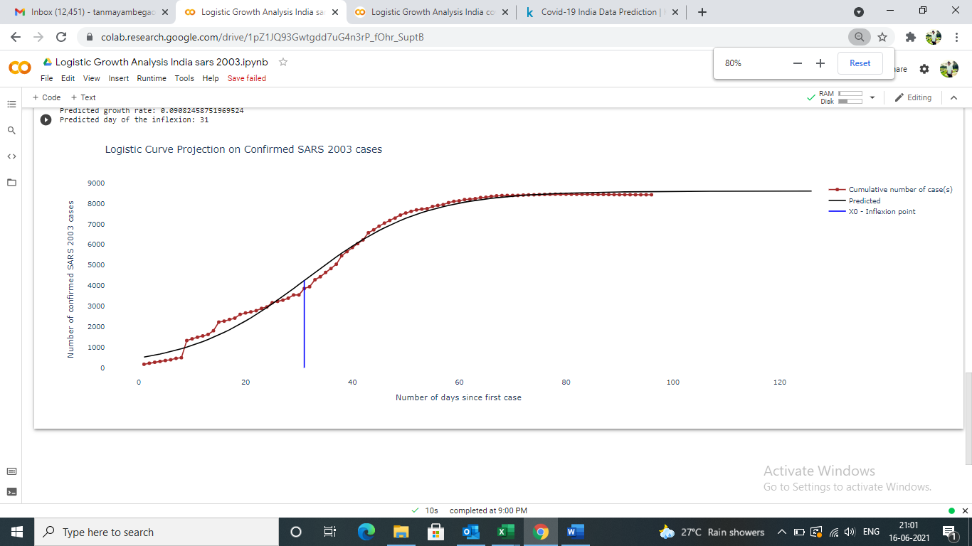
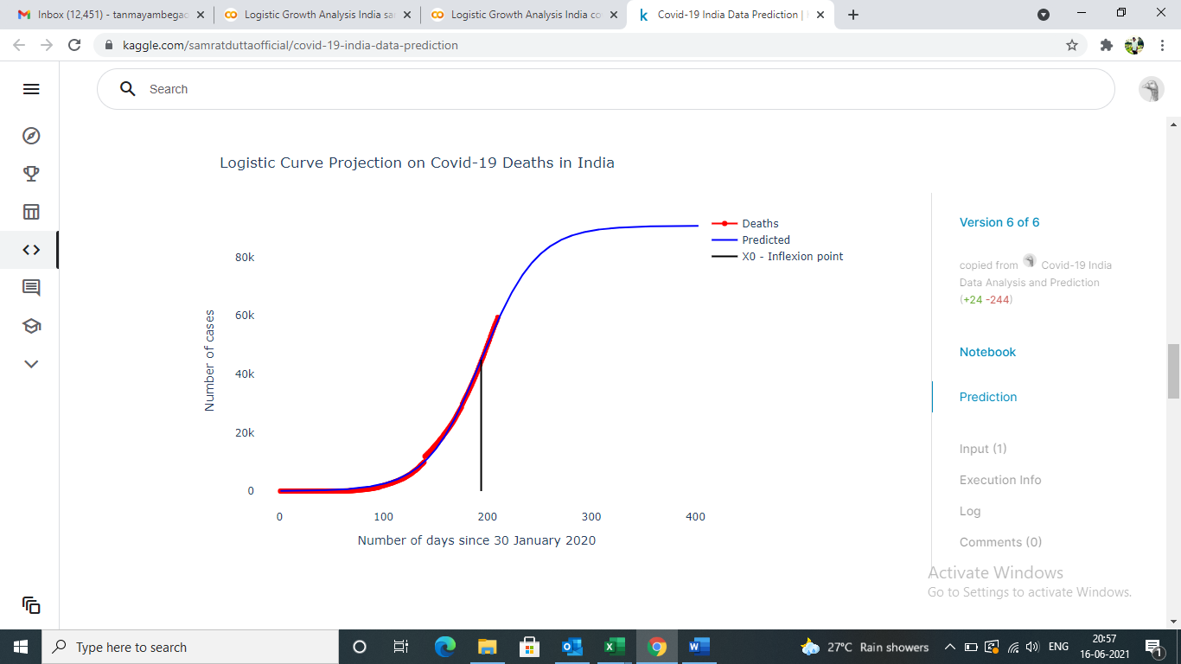
RESULTS AND ANALYSIS (GROWTH ANALYSIS)
Logistic Regression
Fig. For SARS 2003 Global Fig. For Covid-19 in India

Slide 15
RESULT AND ANALYSIS (GROWTH ANALYSIS)
R2 SCORE
ii. MAE Score
 | Linear Regression | Logistic Regression | Gompertz Curve Model
SARS 2003 DATASET | 0.8065 | 0.9219 | 0.8876
COVID-19 IN INDIA | 0.9012 | 0.951 | 0.7652
 | Linear Regression | Logistic Regression | Gompertz Curve Model
SARS 2003 DATASET | 9.925 | 1.236 | 6.9521
COVID-19 IN INDIA | 3.379 | 2.341 | 20.123

Slide 16
METHODOLOGY (SENTIMENT ANALYSIS)
Twitter Developer Account
Data Extraction
Data Pre-Processing
Modelling and Labelling the Data
Plotting the data
Get Access key and Consumer Key
25000 tweets are allowed to be extracted per month
Using Tweepy package and ‘#covaxin’ and ‘#covishield’ as delimiter.
Merge the datasets based on vaccine and on months.
Removing punctuations
Tokenisation
Removing Stop words
Lammetization/Stemming
Used VADER tool for classifying and labelling the data into –Positive, negative and neutral
Seaborn and matplotlib library to plot the data

Slide 17
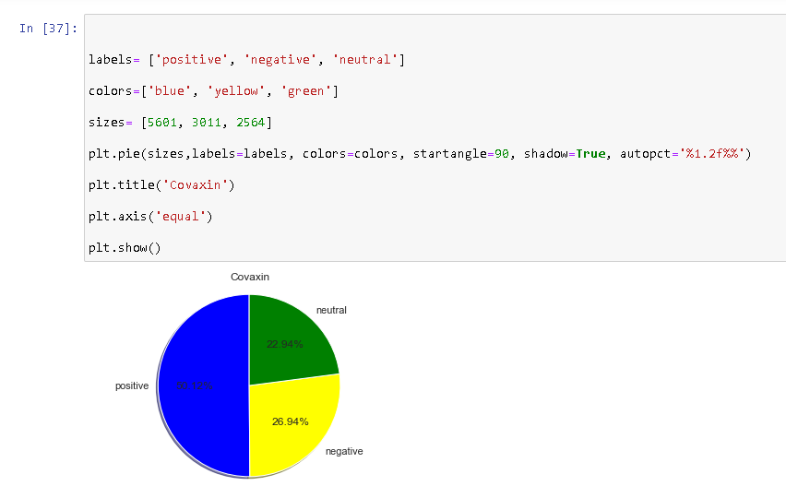
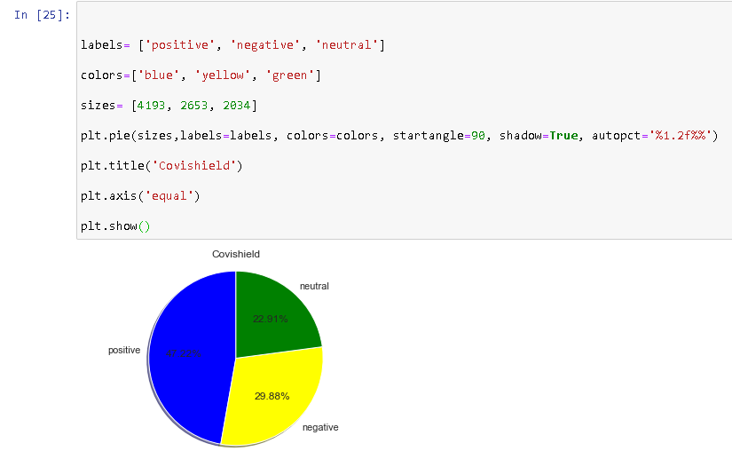
RESULTS & ANALYSIS (SENTIMENT ANALYSIS)
Sentiment analysis results for Vaccines:
Vaccine | Total number of tweets | Positive sentiment % | Negative sentiment % | Neutral sentiment %
Covaxin | 11176 | 50.12 | 26.94 | 22.94
Covishield | 8880 | 47.22 | 29.88 | 22.91

Slide 18
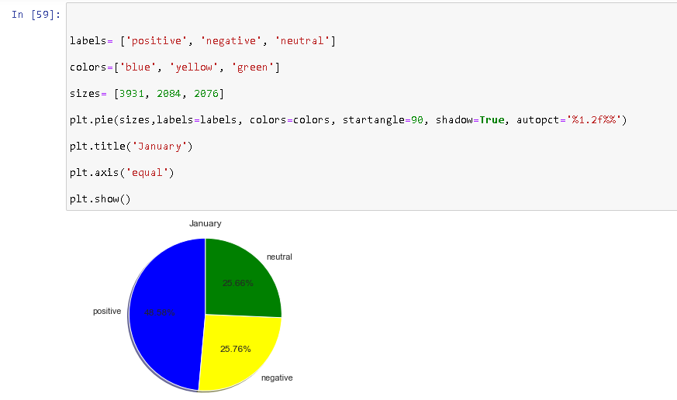
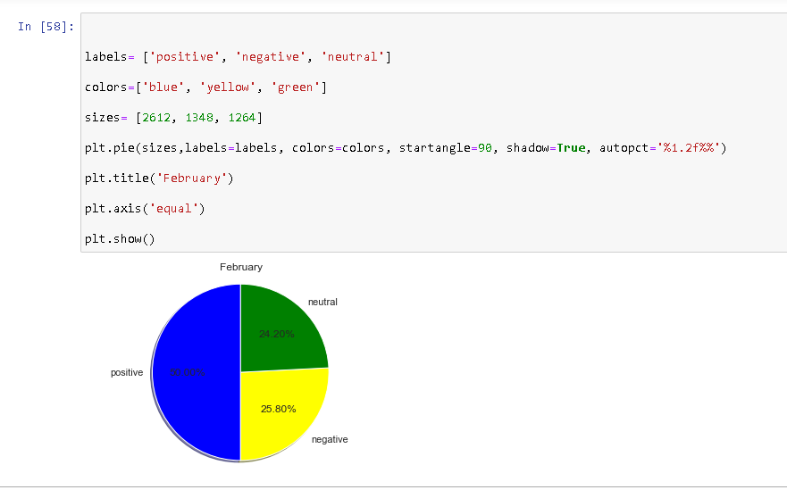
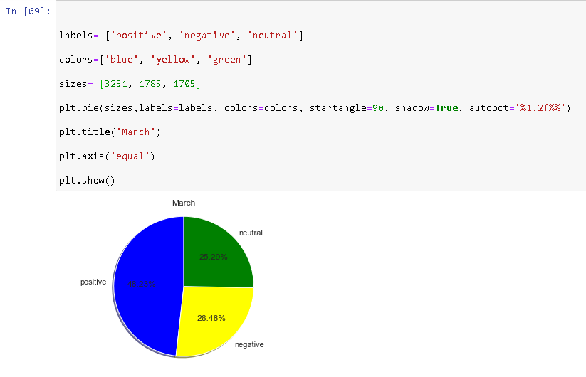
RESULTS & ANALYSIS(SENTIMENT ANALYSIS)
Month wise sentiment analysis results for both Vaccines:
Month | Total number of tweets | Positive sentiment % | Negative sentiment % | Neutral sentiment %
January | 8091 | 48.58 | 25.76 | 25.66
February | 5224 | 50.00 | 25.80 | 24.20
March | 6741 | 48.23 | 26.48 | 25.29

Slide 19
CONCLUSION
Conclusions based on results
Limitations
Future Scope
Impact on Society
The best model based on accuracy and error rate is – Logistic Regression
Higher percentage of positive sentiments for Covaxin compared to Covishield.
Positive percentage for vaccines increased from Jan to Feb but decreased from Feb to March
The number of confirmed cases for Coronavirus can vary according to external factors such as Lockdowns.
Misleading sentiments because of propaganda tweets.
Developing models which can take external factors into consideration.
Classify sentiments into other emotions such as happy, sad, anger, trust.
Both the analysis can help the government make informed decisions and also realize the actual scenario.

Slide 20
REFERENCES
Journal/Paper
[1] Modelling and Forecasting Covid-19 Growth Curve in India by Vikas Kumar Sharma and Unnati Nigam
[2] Modelling and predicting the spatio-temporal spread of COVID-19 in Italy by Diego Guiliani, Maria Michela Dickson and Flavio Santi
[3] Modelling avian growth with the unified-Richards by Tjørve KCM and Tjørve E.
[4] Disinformation, ‘Fake News’ and influence Campaigns on Twitter by Matthew Hindman, George Washington University
[5] Sentiment analysis of social media response on the covid19 by Bhat, M., Qadri, M., Noor- ul-Asrar Beg, M. K., Ahanger, N., & Agarwal, B. (2020)
[6] Public Sentiment Analysis of COVID19 Vaccination Drive in India by Dr. Akash D Dubey, Jaipuria institute of Management, Jaipur
Web
[1] https://www.kaggle.com/imdevskp/sars-outbreak-2003-complete-dataset
[2] https://www.kaggle.com/imdevskp/covid_19_india

